Slide 1
Strategic planning – Past to Present
Making Connections
Susan Hasenauer
Newark Central School District Superintendent

Slide 2
Summary
Strategic planning is a powerful tool for supporting the mission, vision, and core beliefs in a public school district.
Strategic planning positively affects student achievement.
Strategic planning is closely aligned to planning initiatives and to the development and oversight of the annual district budget.

Slide 3
PAST Process
Surveys
Focus Groups (Students, staff, BOE, community members, parents)
SWOT (Strengths, weakness, opportunities, threats)
DATA (ESSA, NYS Report Card, local assessments, enrollment, US census)

Slide 4
Vision
Road Map
Every Student, Every Day

Slide 5
THE big Rocks…Identifying your Priorities
1. School/Community/Family Partnerships
2. Academic Programming
3. Culture and Climate

Slide 6
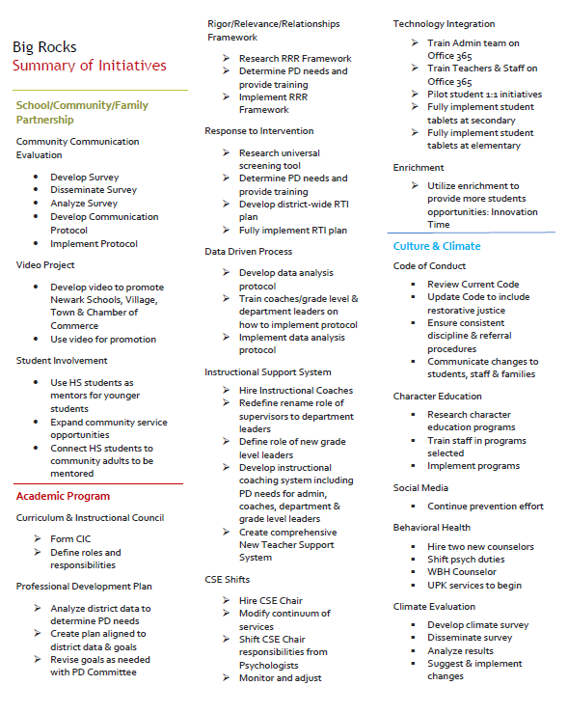

Slide 7
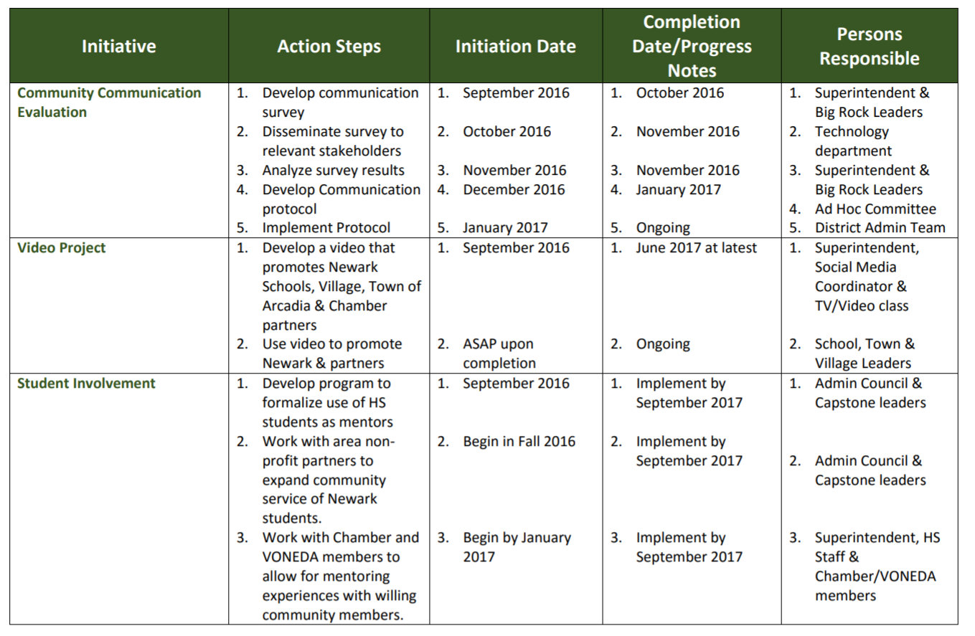
BIG ROCK 1: CREATE A SCHOOL, FAMILY AND COMMUNITY PARTNERSHIP TO INCREASE COMMUNICATION AND CONNECTIONS AS WE BUILD A HOMETOWN PRIDE

Slide 9
What’s Missing?
Mission
Core Beliefs
Strategic Priority
Guiding Strategies
Desired Outcomes
Evidence
DCIP/SCEP Plans

Slide 10
Effort vs. Impact
A desired outcome is a statement that makes goals more concrete. To develop a useful set of desired outcomes you will need to describe what specific change(s) you hope to occur as a direct result of your program that will help you achieve your goals.

Slide 11
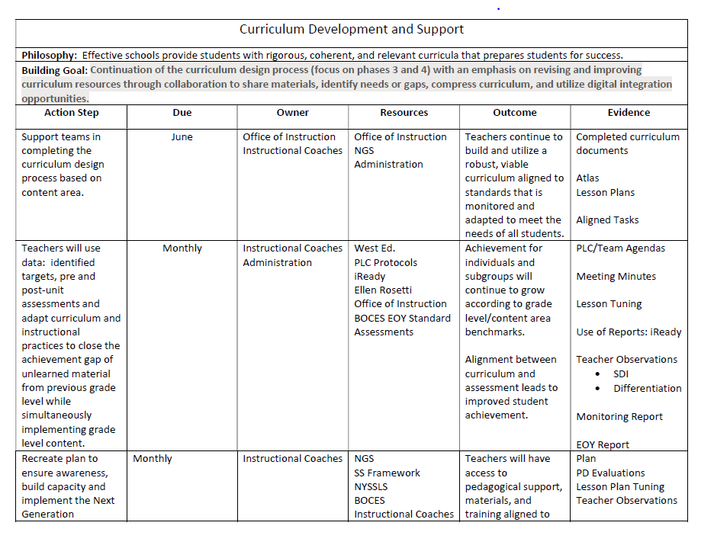

Slide 13
Effective districts…
Systems and Organization: Establish systems and structures that promote continuous improvement and success for all students.
Leadership: Create a school community and culture that leads to success, well-being and high academic outcomes for all students.
Curriculum Development and Support (Academic Programming): Provide students with rigorous, coherent, and relevant curricula that prepares students for success.
Research-based Practices and Collaboration (Academic Programming): Effective teachers engage with students in a manner that promotes mastery and allows students to stretch their knowledge and deepen their understanding.
Social and Emotional Health/Community of Caring (Culture and Climate): Effective schools develop a systematic approach to Social-Emotional Learning to ensure that all students can develop social-emotional learning skills necessary for success within and beyond school.
Family and Community Engagement: Effective schools develop a systematic approach to Family and Community Engagement to empower parents to effectively advocate for their child’s learning and for the improvement of the school.

Slide 14
Systems and Organization
Leadership: To ensure the school community understands and promotes a distinctive vision for student achievement and accountability as identified by specific, measurable, ambitious, results orientated and timely goals that reflect urgent priorities aligned to vision and mission.
Curriculum: To ensure the district has a cohesive & comprehensive curricula aligned to NYS standards in all content areas K -12.
Pedagogy: To ensure teachers understand and utilize research- based strategies that are responsive to students' strengths and needs leading to high levels of engagement and inquiry.
Family Engagement: To ensure the school community partners with families and community agencies to promote and provide professional development across all areas to support student success.
Social/Emotional: To ensure there is a strategic and comprehensive K-12 system of support that addresses both academic and social emotional barriers impacting achievement.
Continuous Improvement

Slide 15
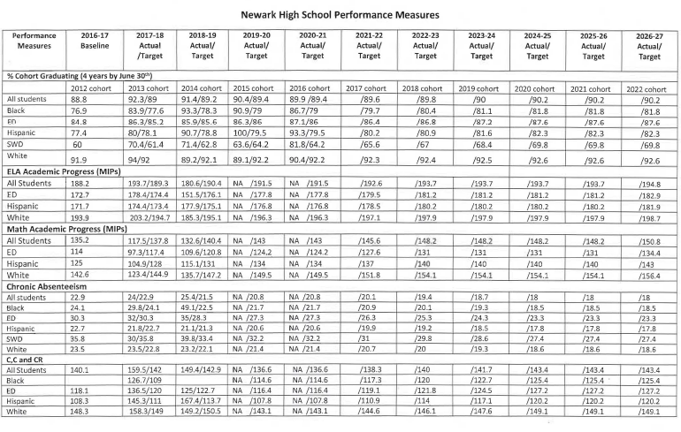

Slide 16
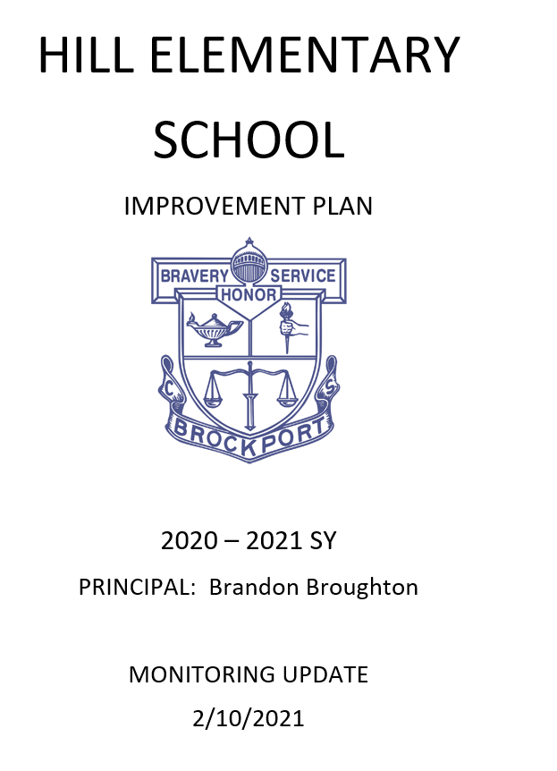
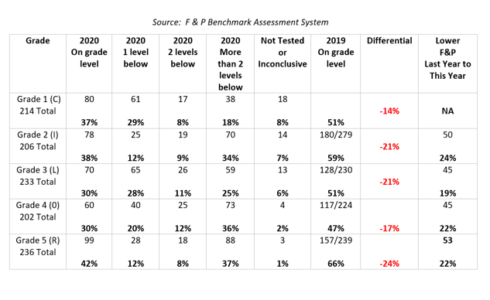

Slide 17
IMPLEMENT - MONITOR - EVALUATE - Adjust

Slide 19
https://slidetodoc.com/newark-csd-district-and-building-plans-2020-21/

