Slide 1
Strategic Planning for Public School Districts
Stephen P. Miskell, Ed.D., Four County SBA Executive Director
Susan Hasenauer, Superintendent, Newark Central School District
Jamie Farr, Superintendent, Canandaigua City School District
Jeramy Clingerman, Superintendent, Seneca Falls Central School

Slide 2
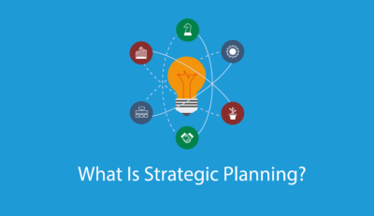
Strategic Planning
A road map for what an organization is, does, and for what purpose.
Strategic planning takes place in many school districts –why?
Common Core Learning Standards
School Report Card data reported by NYSED
Focus on high stakes testing and accountability
Notes:
ESSA becomes law, replacing NCLB in 2015

Slide 3
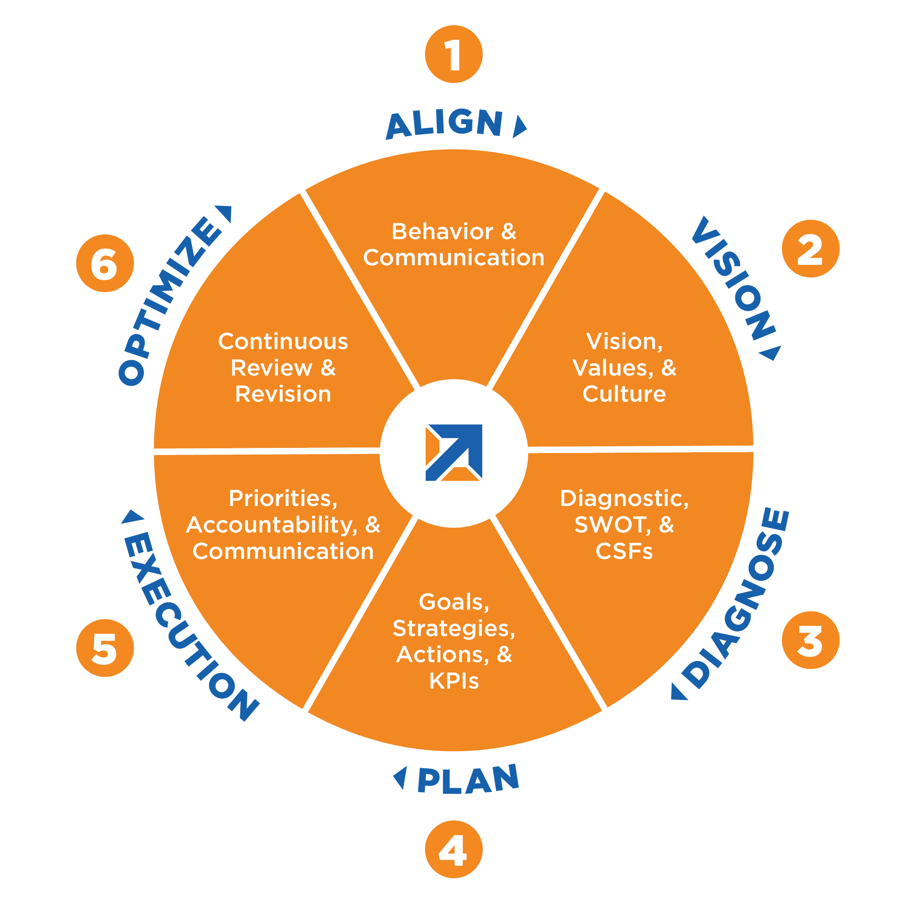
Strategic Planning Elements
Mission – The “raison d’etre” of an organization. Why the organization exists; whom it serves; the needs it addresses.
Vision – Focus on the future. Where the organization aspires to be in the future.
Goals – An object or aim of an action, to attain a specific standard of proficiency within a specified period (Locke and Latham, 2002).
Notes:
Common elements

Slide 4
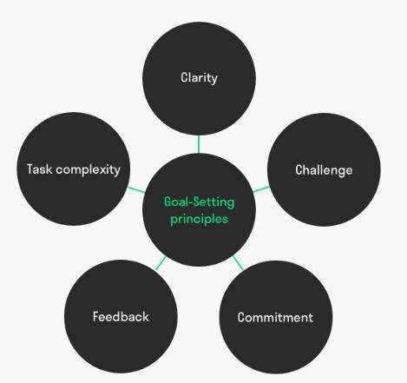
Theoretical Rationale
The Goal Setting Theory (Locke and Latham, 1990, 2002).
Goals must be specific, challenging, and attainable.
A framework for connecting strategic planning in public school districts to goals designed to improve student achievement.
SMART Goals are an outgrowth of the Goal Setting Theory.
Notes:
The purpose of this study is to determine the role of strategic planning in the achievement of goals established to improve academic success.

Slide 5
Research Questions
1. According to the framework developed by Locke and Latham (2002), what type of goals are being developed and included in strategic plans in public school districts?
2. If strategic planning is being used, how are the goals contained in the plans being implemented?
3. How are strategic plans in rural public school districts being monitored?

Slide 6
Potential Significance
There are few studies about strategic planning in public school districts in the U.S.
Key stakeholders (school administrators, school boards in particular) could benefit from an examination of strategic planning.
Strategic planning is relevant to the field of education.

Slide 7
What does the literature say?
Mission statements provide goal clarification and the development of strategy (Lake and Mrozinki, 2011).
Vision and mission statements describe a school’s purpose and priorities (Allen, Kern, Vella-Brodrick and Waters, 2018).
School principals report a strong connection between mission statements and classroom practices and institutional identity (Stemler, Bebell, and Sonnabend (2011).

Slide 8
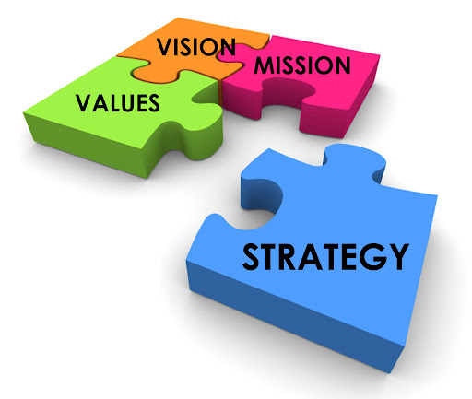
What does the literature say?
Mission statements guide the whole process of strategic planning; vision statements look to the future (Ozdem, 2011).
It is essential for strategic plans to include goals that are SMART (Leonard and Huang, 2014).
A clear understanding of an organization’s mission statement increases commitment to an organization (Bart, Bontis, Nick, and Taggar, 2001).
Notes:
SMART goals are Specific, Measurable, attainable, relevant, and time-bound.

Slide 9
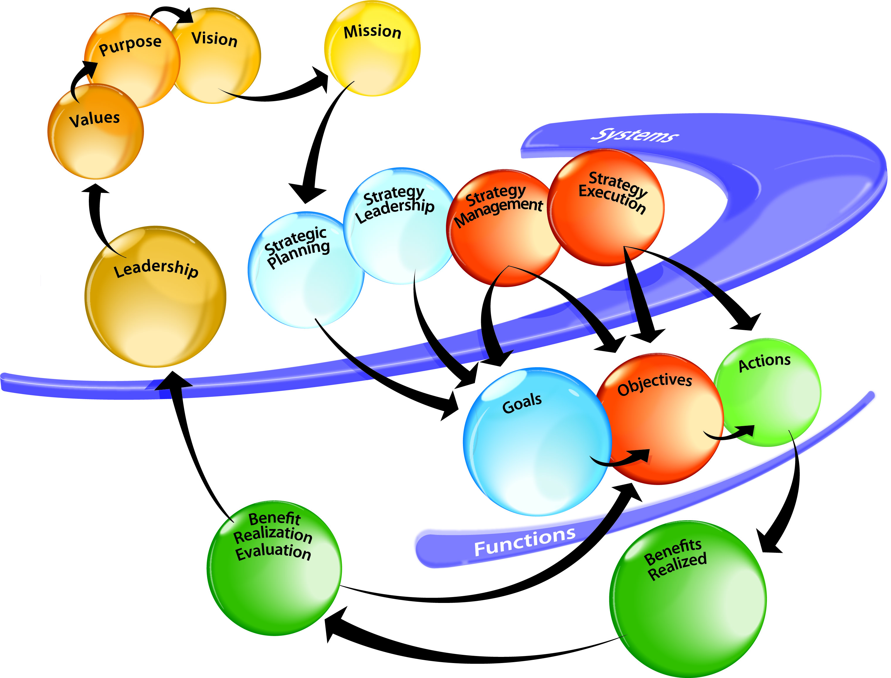
What does the literature say?
Strategic planning positively affect performance (Miller and Cardinal, 1994).
Strategic planning has a positive and predictive relationship with performance (Sandala, Pooe, and Dhurup, 2014).
Strategic planning increases a firm’s financial performance (Arend, Zhao, Song, and Subin, 2017).

Slide 10
What does the literature say?
Strategic planning and planning flexibility are positively associated (Dibrell, Craig, and Neubaum, 2013).
To successfully develop and maintain a strategic plan, key stakeholders must understand the concept of strategic planning (Wanjala and Rarieya, 2014).

Slide 11
What does the literature say?
Strategic planning in higher education institutions improves performance (Aleong, 2007).
College administrators are more likely to support strategic planning than faculty members (Welsh, Nunez, and Petrosko, 2005).

Slide 12
What does the literature say?
Although empirical research in strategic planning declined in the mid 1990s, the practice of strategic planning remains widespread at many types of organizations.
The lack of research in strategic planning is most evident with regard to public schools, particularly in the United States.

Slide 13
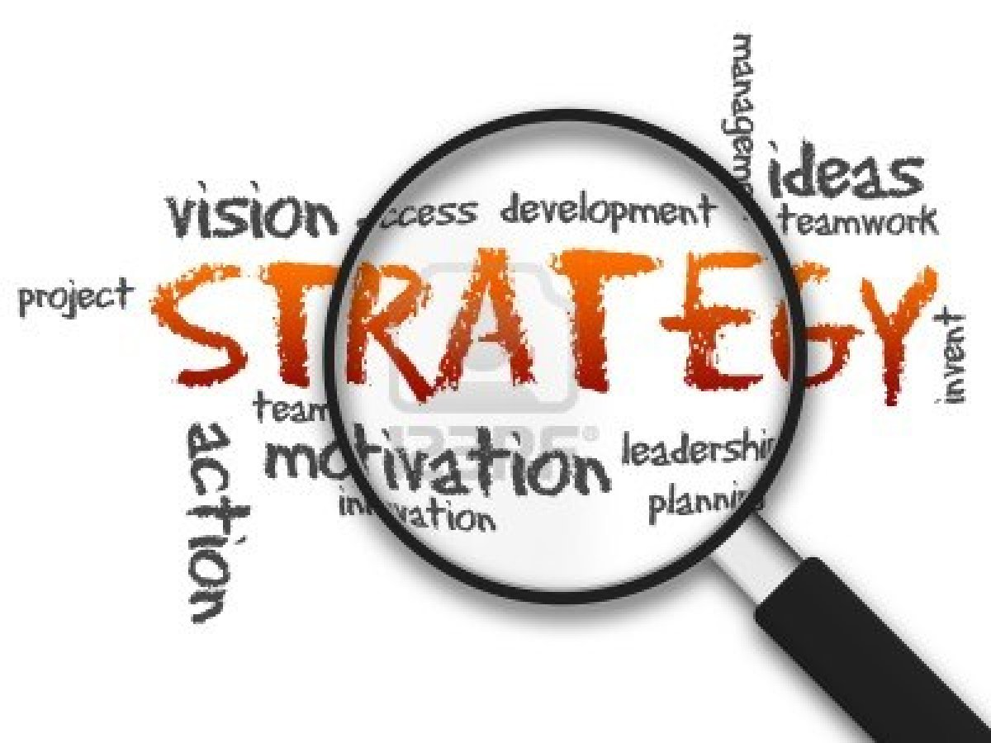
Research Design
Qualitative research methodology.
Lived experiences of current public school superintendents (Creswell and Poth, 2018).
Semi-structured interviews with rural school superintendents in public school districts where strategic planning is in place.
Understand what goals for academic achievement are included in strategic plans and how the goal attainment is measured, or progress toward goal attainment is measured in each participating district.
This Photo by Unknown Author is licensed under CC BY-SA

Slide 14
Research Context
Rural School Districts in Western and Northern New York State
Wayne County population approximately 91,000
Livingston County population approximately 64,000
Jefferson County population approximately 114,000
11 Pre-K-12 school districts
Rural school districts ranged in size from 300 students to 2,500 students.
This Photo by Unknown Author is licensed under CC BY-SA

Slide 15
Results
Research Question 1:
According to the framework developed by Locke and Latham (1990, 2002), what type of goals are being developed and included in strategic plans in public school districts?
Theme 1 – Goals that are aligned to planning initiatives.
Theme 2 – Goals that are measurable.
Theme 3 – Goals that cascade, or spiral down.
Notes:
Chapter 4

Slide 16
Results
Research Question 2:
If strategic planning is being used in rural schools, how are goals in the strategic plan being implemented?
Research Question 3:
How are strategic plans in rural school districts being monitored?
Theme 1 – Distributive leadership.
Theme 2 – Alignment.
Theme – Progress monitoring.

Slide 17
Findings
Finding 1 – Goals developed during the strategic planning process in districts studied supported the districts’ mission, vision and core beliefs.
All twelve school administrators who participated in this study supported this finding.

Slide 18
Findings
Finding 2 – The practice of strategic planning in school districts studied affected student achievement positively.
All twelve administrators who participated in this study supported this finding.

Slide 19
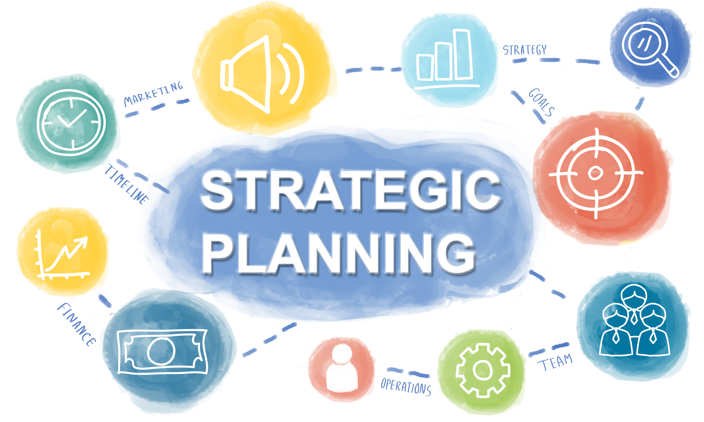
Findings
Finding 3 – School districts studied implement goals through distributed leadership.
Just as goals cascade, or spiral down in strategic plans, the responsibility for implementing and sustaining established goals was distributed by superintendents to principals and to teachers.

Slide 20
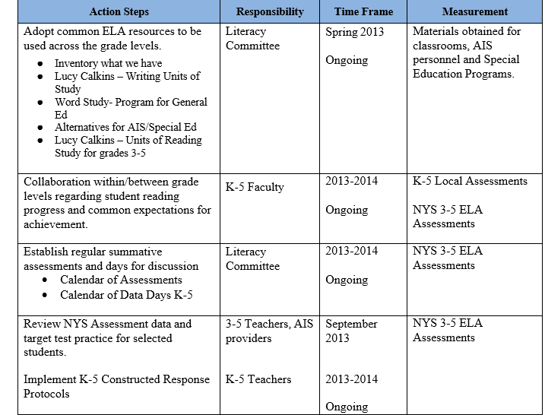
Geneseo Central
Teaching and Learning – Goal 1
Strategic Issue: Academic Achievement
Goal: 90% of our children will read at or above grade level by the end of 3rd grade.

Slide 21
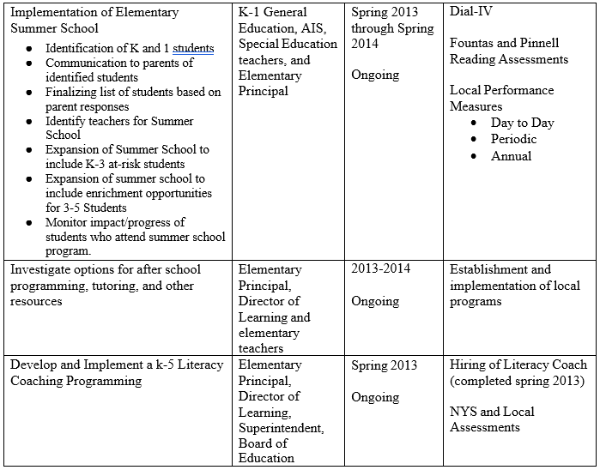
GCSD
Teaching and Learning – Goal 1
Strategic Issue: Academic Achievement
Goal: 90% of our children will read at or above grade level by the end of 3rd grade.

Slide 22
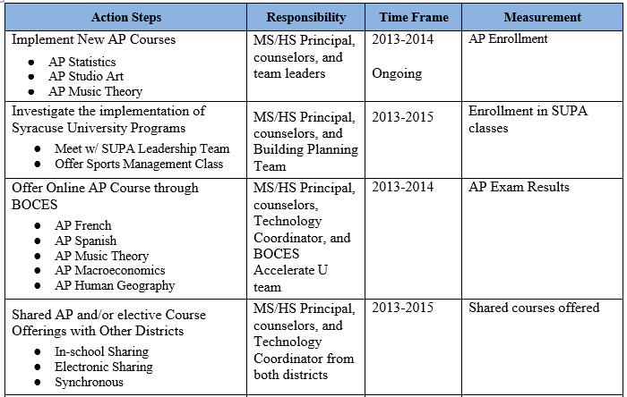
GCSD
Teaching and Learning – Goal 2
Strategic Issue: Academic Rigor
Goal: 90% of our students will take at least one AP class before graduating from high school.

Slide 23
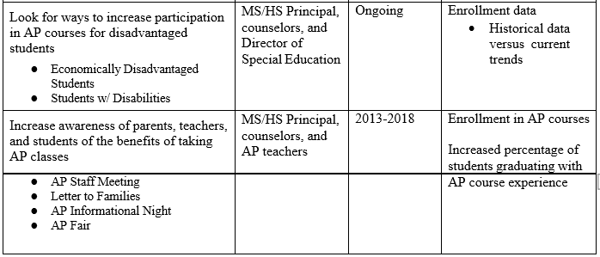
GCSD
Teaching and Learning – Goal 2
Strategic Issue: Academic Rigor
Goal: 90% of our students will take at least one AP class before graduating from high school.

Slide 24
Recommendations for Practice
Results of this study may be used to facilitate buy-in of the strategic planning process.
Results of this study may encourage public school districts to examine their current strategic plans to make modifications based on the findings of this study.
Results of the study indicated the importance of establishing data driven and measurable goals aligned to the district’s mission, vision and goals.
Results of the study contributed to the validity of using strategic planning in educational settings. Given that all participants in this study indicated that strategic planning positively affects student achievement, strategic planning is a worthwhile and productive practice for public school districts.

Slide 25
Summary
Strategic planning is a powerful tool for supporting the mission, vision, and core beliefs in a public school district.
Strategic planning positively affects student achievement.
Strategic planning is closely aligned to planning initiatives and to the development and oversight of the annual district budget.

Slide 26
Study Citation
Miskell, Stephen P. “A Study of the Effect of Strategic Planning on Student Achievement in Rural Public Schools in New York State (2020). Education Doctoral. Paper 471
https://fisherpub.sjfc.edu/education_etd/471.
Notes:
Common elements

Slide 27
Discussion
Susan Hasenauer, Superintendent, Newark Central School District
Jamie Farr, Superintendent, Canandaigua City School District
Jeramy Clingerman, Superintendent, Seneca Falls Central School

Slide 28
Strategic Planning aligned to District efforts
Strategic planning can (and should) be aligned to school and district initiatives:
Stakeholder involvement
Reporting and data sharing
Professional development
Profiles of a learner/graduate

Slide 29
Strategic Planning and Stakeholder involvement
Which stakeholder groups are included in opportunities to plan, study, and report?
How are stakeholder groups engaged in meaningful and reciprocal ways?
Which data and reporting are shared with stakeholder groups? When? How does the school/district know that groups can access and make use of reporting?

Slide 30
Strategic Planning and Professional Development
How is teacher professional development organized?
How are topics and areas of study selected?
How do development opportunities scaffold?
What supports are available to novice teachers and teachers new to the school/district?
Notes:
University model?
Teacher input and leadership in identifying and creating development opportunities

Slide 31
Strategic Planning and Profiles of a learner/graduate
How do schools and districts bridge the gap between high school graduation and what comes next?
Progress from a focus of on-time graduation and the correct academic credentials.
Which skills and dispositions do districts believe students should embody and exemplify by graduation?
Align school operations and pedagogy to a collective vision for student success
The community establishes a clear understanding for what it means for students to be college, career, and life ready.
Notes:
A Portrait of a learner/Graduate represents a school district's vision for the 21st century skills, character traits, and/or social-emotional competencies that students need to succeed in college, career, and life.
The process of building and implementing a Portrait of a Graduate is a community effort. Typically, districts bring together students, staff, teachers, community leaders, business leaders, and school administrators to create the portrait.
This portrait should complement academics and test scores as measures of preparedness. Typically, districts bring together students, staff, teachers, community leaders, business leaders, and school administrators to create the portrait.

Slide 32
Profiles of a learner/graduate May address national trends
Enrollment in college:
Many students are choosing not to enroll in college, even as the job market increasingly advantages those with associate’s or bachelor’s degrees.
Remedial courses:
A large number of students require remedial courses in ELA and/or math.
Graduation rates:
College graduation rates are hovering at around 60%.
There is a disparity in readiness and post-secondary education outcomes for underserved students.
Employment:
Employers report a significant need for high school graduates to receive additional education and training.
Notes:
Many students are choosing not to enroll in college, whether a two-year or four-year institution, even as the job market increasingly advantages those with an associate’s or bachelor’s degree. A large number of students who do enroll in college require remedial courses in ELA and/or math.
Graduation rates at colleges are hovering at around 60 percent. There is a large disparity in readiness and post-secondary education outcomes for underserved students, including students of color, poor students, and first-generation college students.
Employers are reporting a significant need for high school graduates to receive additional education and training to make up for gaps.
According to the 2018 Gallup Superintendents survey, 66 percent of superintendents ranked SEL/21st-Century Skills as a key area of need and a lever for improving students' college and career readiness.

Slide 33
Profiles of a learner/graduate: Everett Public Schools

Slide 34
Profiles of a learner/graduate: Council Bluffs Community SD

Slide 35
Profiles of a learner/graduate: Schertz-Cibolo-Universal City ISD

Slide 36
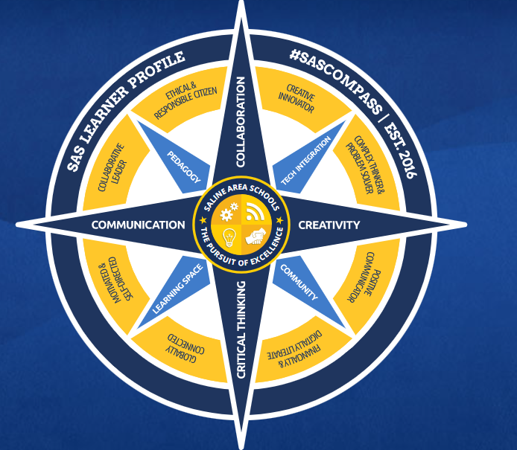
Saline Schools
Notes:
https://www.salineschools.org/sas-vision/sas-compass/

Slide 37
Discussion

